Slide 1
MS Computer Science – Computing Systems (CompSys)
Session for those without Computer Science background
MSCS CompSys Co-ordinator
Prof. Jun Xu
jx@gatech.edu
August 12, 2025
School of Computer Science

Slide 2
Some Relevant Faculty Members
Prof. Joy Arulray
(arulraj@cc.gatech.edu)
Database Systems and Analytics
Prof. Jun Xu
(jx@gatech.edu)
Network Systems and theory
Prof. Jan Van den Brand
vdbrand@gatech.edu
Theory, Algebraic Algorithms, Optimization
Prof. Gerandy Brito
gbrito3@gatech.edu
Theory and Algorithms
Prof. Ada Gavrilovska
ada@cc.gatech.edu
Systems, Cloud, Distributed Systems
Prof. Kishore Ramachandran
rama@cc.gatech.edu
Parallel and Distributed Systems, Cloud, Embedded Systems

Slide 3
About the College
College of Computing (CoC) was established at Georgia Tech in 1990. Initially it contained only one school (department): Computer Science.
Now the college has 4 schools, plus one for teaching only:
  School of Computer Science (CS)
  School of Interactive Computing (IC)
  School of Computational Science and Engineering (CSE)
  School of Cybersecurity and Privacy (CP)
  AND the School of Computing Instruction (SCI)

Slide 4
About the college- continued
The latest School of Cybersecurity and Privacy gives its own M.S in Cybersecurity specialization.
As M.S. students, you are NOT affected by what course is taught by faculty from which school. You have to meet the requirements of your specialization.

Slide 5
Specializations
UNDER CS (Computer Science)
ONLY ONE SPECIALIZATION-
Computing Systems
UNDER CSE (Computational Science and Engineering):
Modeling and Simulation
High Performance Computing
Visual Analytics
UNDER IC (Interactive Computing)
Computational Perception and Robotics
Computer Graphics
Human Centered Computing
Human Computer Interaction
Interactive Intelligence
Machine Learning
Scientific Computing
Social Computing

Slide 6
Who are here from these other Specializations?
NOTE THAT EACH OF THESE SPECIALIZATIONS HAVE THEIR OWN REQUIREMENTS.
UNDER CSE (Computational Science and Engineering):
Modeling and Simulation
High Performance Computing
Visual Analytics
UNDER IC (Interactive Computing)
Computational Perception and Robotics
Computer Graphics
Human Centered Computing
Human Computer Interaction
Interactive Intelligence
Machine Learning
Scientific Computing
Social Computing

Slide 7
We are here to answer any questions you have, but we will mainly limit ourselves to the Computing Systems specialization.

Slide 8
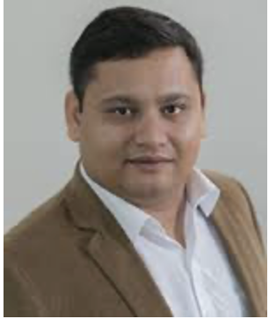
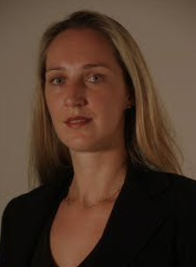
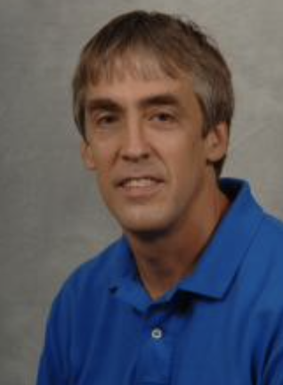
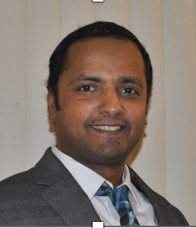
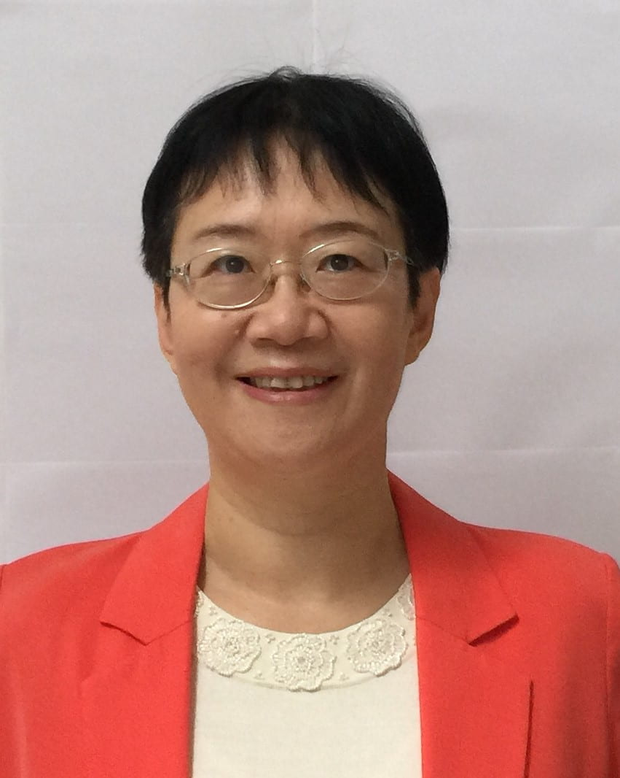
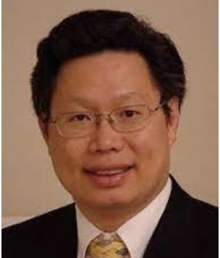
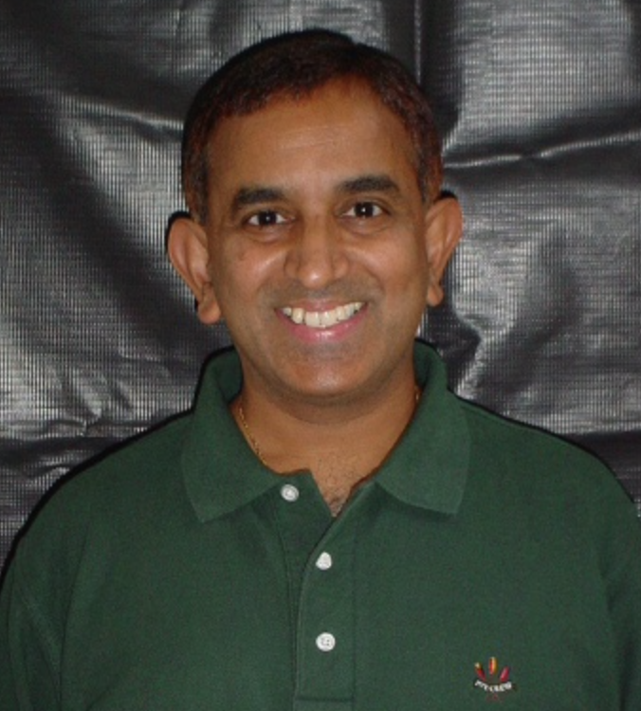
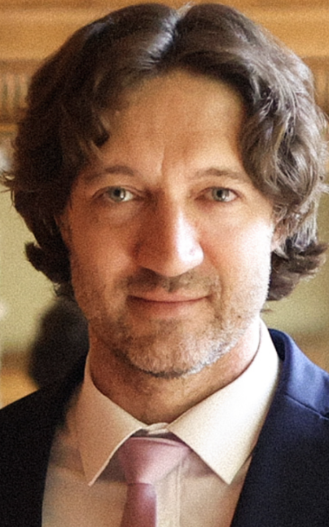
Systems Faculty Members
Ketan Bhardwaj
Ada Gavrilovska​
Greg Eisenhauer​
Anand Iyer
Calton Pu​
Kishore Ramachandran
Ling Liu
Alexey Tumanov​

Slide 9
Courses offered in Fall 2024
CS3210 Design of Operating Systems (Anand Iyer)
CS 6210 Advanced Operating Systems (Ada Gavrilovska​)
CS 6211 System Design for Cloud Computing (Fall 2024) (Kishore Ramachandran)
CS4220/6235, Real-Time and Embedded Systems (Calton Pu)
CS6220 Big Data Systems and Analytics (Ling Liu)
CS8803-SMR Systems for Machine Learning (Alexey Tumanov​)

Slide 10
Courses offered in Spring 2025
CS3210 A/GR Design of Operating Systems (Alexey Tumanov​)
CS 6210 Advanced Operating Systems (Anand Iyer​)
CS 2200 Introduction to Computer Systems and Networking (Kishore Ramachandran)
CS4365/6365, Introduction to Enterprise Computing (Calton Pu)
CS 7210 Distributed Computing (Ada Gavrilovska​)
CS4675/CS6675 Advanced Internet Systems and Application Development (Ling Liu)

Slide 11
Some Remedial Courses in Systems
  CS6200 is an Introduction to Operating Systems course under the OMCS online program. It counts as elective but will not be counted as a core requirement course. Note that this course is NOT
available to on-campus students.
CS3210 Design of Operating Systems is the introductory course at undergtraduate level. It will not count at all under M.S. requirements. Similarly, any 2000 level pre-requisites will also not count.

Slide 12
A note about CS3210
This is provided by Prof. Kishore Ramachandran
CS 3210 is NOT a traditional OS course. It does NOT teach basic OS concepts which students should have learned in CS 2200
CS 3210 is a hands on project oriented course which assumes that students already have had CS 2200 or its equivalent. We don’t want any surprises for the students
CS2200: An Introduction to Computer Systems and Networks, and CS2110 – Computer Organization and C programming are pre-requisites for CS3210

Slide 13
An Algorithm to Evaluate your Background
This is provided by Prof. Kishore Ramachandran
Here is an “algorithm” for students to do a self-determination
>>>
If (no logic design preparation) then
CS 2110: Computer Organization and C Programming //GR section for graduate students P/F and Audit options
elsif (no computer systems preparation) then
CS 2200: Introduction to Computer Systems and Networking //GR section for graduate students P/F and Audit options
else // have had basic computer architecture and OS course in UG
CS 3210: Operating Systems Design // assumes students have had equivalent of CS 2200
end
// CS 4210 is a cross-listed course with CS 6210 Advanced OS
>>>

Slide 14
Remedial algorithm courses
CS 3510 is almost equivalent to CS 6515.
For students who have never taken a course on data structures, CS 1332 (Data Structures and Algorithms) is a remedial course to take. It teaches arrays, trees, linked lists, recursion, etc.
You also need to know how to prove things using techniques such as induction (taught in CS 2050 – Discrete Mathematics).

Slide 15
QUESTIONS?

